Slide 1
Predicting Helpfulness of Amazon Product Reviews
Fan Zhang(Fanny) &
Yueying Zhang(Sharon)
Notes:
Hello, everyone. This is Sharon.
For the final project, Fanny and I have studied on Predicting helpfulness of Amazon Product Reviews.
In this video, I would like to share our findings with you.

Slide 2
Part 1 Motivation
Part 2 Project Question
Content
Part 3 Data Source & Preprocessing
Part 4 Methodologies
Part 5 Empirical Results
Part 6 Limitation
Notes:
Basically, I will start with our motivation and give you a big picture of questions we have studied.
Then I will briefly go through how we preprocessed our data, and what methodologies we have used. After that, I will presents several empirical results of our experiments, and conclude with the best model for predicting helpfulness of product reviews.
Finally, I would like to discuss limitations of our project which promotes further study.

Slide 3
1. Motivation

Slide 4

Part 1 Motivation
Product Reviews : High Volume but Low Quality
Helpfulness Rating: Not Enough Amount
Despite of the high volume of comments, the quality and authenticity of comments are not guaranteed.
However, one crucial problem is that many new or less popular products do not have sufficient votes on review quality.
3.67%
Only 3.67% of all the reviews have more than 10 ratings of helpfulness.
We believe displaying the reviews with higher quality will not only enable users to make a better purchase decision and improve user experience, but also provide producers with better feedbacks on how to improve their products.
Notes:
Many websites such as Amazon ask users to rate and comment on the products. Despite of the high volume of comments, the quality
and authenticity of comments are not guaranteed. Therefore, websites like Amazon allows users to vote on the helpfulness of reviews
so as to provide new customers with information of higher quality.
However, one crucial problem is that many new or less popular products do not have sufficient votes on review quality.
We believe displaying the reviews with higher quality will not only enable users to make a better purchase decision and improve user experience, but also provide producers with better feedbacks on how to improve their products.

Slide 5
2. Project Question
Notes:
【链接】Our project is guided by two important questions:

Slide 6
Part 2 Project Question
What features will have a great predictive power of whether a review is helpful or not? E.g. How to identify “rational” comments from emotional comments?
What’s the best classification algorithm for “helpfulness” prediction?
Notes:
What features will have a great predictive power of whether a review is helpful or not? For example, How do we identify rational comments from emotional comments?
Which classification algorithm will perform best in terms of the accuracy of “helpfulness” prediction?

Slide 7
3. Data Source
& Pre-processing
Notes:
【链接】Before move on the methodologies, let’s first take a look on the data.

Slide 8
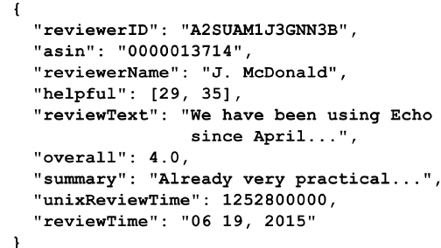
Part 3 Data Preprocessing
Data Source:
Amazon product dataset provided by Julian McAuley from UCSD (http://jmcauley.ucsd.edu/data/amazon/ ) and we will focus App for Android.
Sampling:
Randomly choose samples with at least 20 votes for helpfulness.
Columns of interest:
Notes:
Here, we will use the Amazon product dataset provided by Julian McAuley from UCSD. And we will focus on one product category: App for Android.
Randomly choose samples with at least 20 votes for helpfulness.
Here’s a sample entry of reviews. In this project, we would focus on three columns, “helpful”, “reviewtext” and “overall” review score:
Column “helpful” defines the ratio of positive votes, or the helpfulness score,
e.g. [29,35] means 29 of 35 persons vote on “helpful” white the other 1 votes on “unhelpful”.
For those with a helpfulness score >= 0.75, we will classify as “helpful”; < 0.75 as “unhelpful”. Whether a review is helpful or not is what we want to predict.
Column “reviewText” is used to derive feature words.
Column “overall” is customers’ rating towards the products they purchase. The rating ranges from 1 to 5. It is used to derive features.

Slide 9
4. Methodology
Notes:
【链接】Now, let me introduce methods used to in model training.

Slide 10
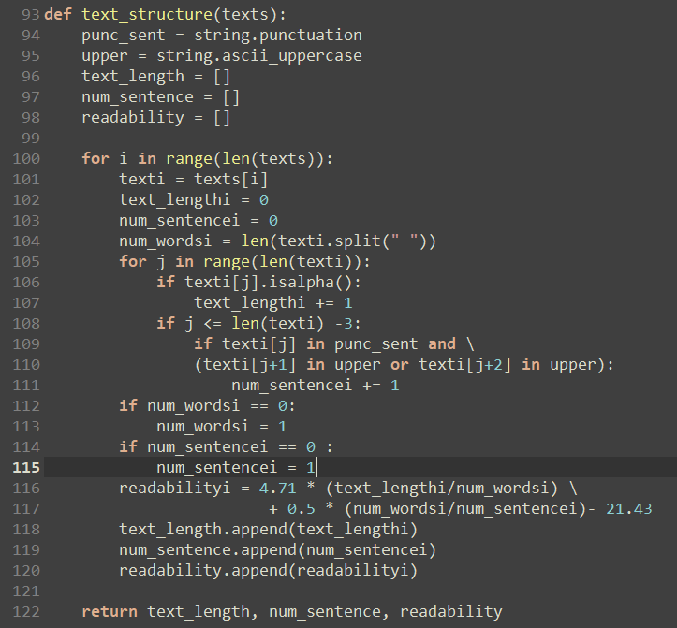
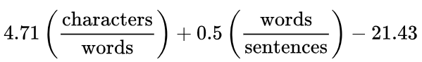
Part 4.1 Feature Extraction
Text Structure features：
# of characters
# of words
# of sentences
Automated Readability Index (ARI)
Notes:
Before training weights, we first need to extract features from texts as input of the model.
It is often the case that the length of reviews is in proportion to customers’ efforts devoted, and thus determines the quality of reviews. Therefore, we first consider text structure features. Here we counted # of characters, # of words and # of sentences.
In addition, to gauge the net “understandability”, we also counted automated readability index as a text structure feature.

Slide 11
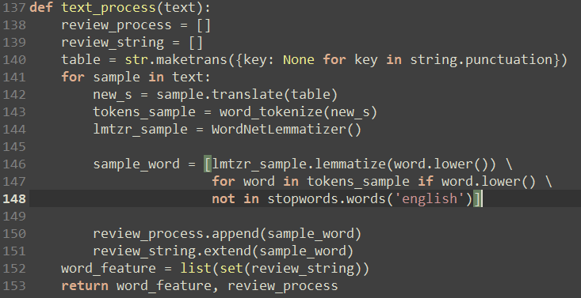
Part 4.1 Feature Extraction
Word Features：
Remove all punctuation
Remove all stopwords
Tokenize strings
Decapitalize words
Lemmatize words
Notes:
Next, we consider word features. Our goal is to find the key words in comments.
Here we removed all punctuation, eliminated stop-words, tokenize strings, and decapitalized words. Most importantly, we lemmatized words to avoid duplicates.

Slide 12
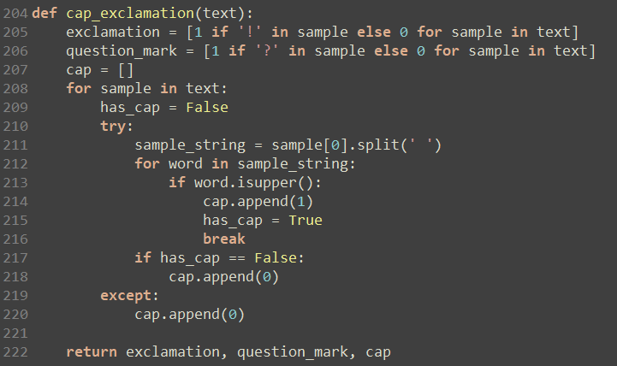
Part 4.1 Feature Extraction
Sentiment Features：
Check if ! In text
Check if ? In text
Check CAPITALIZED WORDS
Notes:
Furthermore, in reality, we finds that comments containing much personal emotions are often irrational and thus unhelpful.
Therefore, we have to extract sentiment features from the texts, including whether there is any exclamation, question marks or Capitalized words.
【链接】Now, we have all the features in the bag and we can move on to weight training.

Slide 13
Part 4.2 Weights Training
Logistic
Naïve Bayes
Supervised learning that estimates probabilities of a given sample being “helpful” or “unhelpful” using a sigmoid function.
Supervised learning that applied Bayes’ Formula in classification. It requires a small amount of training data to estimate parameters and runs fast.
SVM
Supervised learning that tries to map samples to separate categories divided by a clear gap as wide as possible; Effective in high D-spaces.
(Un)Supervised learning that tries to find k training samples closest in distance to the new point, and predict the label from these. It performs well where the decision boundary is very irregular.
KNN
Notes:
Here, we tried four classification algorithms:
Logistic regression: A supervised learning that use a sigmoid function to estimate the probability of a given sample being “helpful” or “unhelpful”.
Naïve Bayes: A supervised learning that applied Bayes’ Formula in classification. It requires a small amount of training data to estimate parameters and runs fast. Here we assumed the likelihood of features follows a Gaussian distribution and used Gaussian Naïve Bayes.
Support Vector Machine: A supervised learning that tries to map samples to separate categories divided by a clear gap as wide as possible; It is effective even in high dimensional spaces.
K Nearest Neighbors: A (Un)Supervised learning that tries to find k training samples closest in distance to the new point, and predict the label from these. It performs well where the decision boundary is very irregular.

Slide 14
5. Empirical Results
Notes:
To come up with the best predicting model, we did some experiments with different classification algorithms, input size, and features.

Slide 15
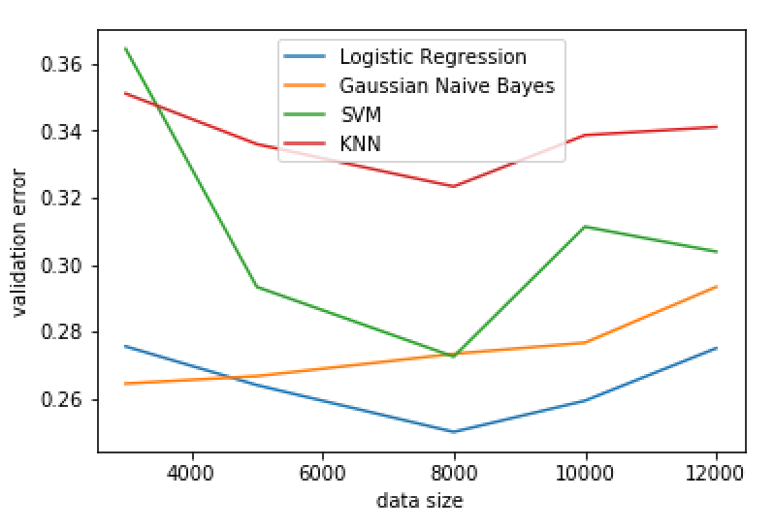
Part 5.1 Four Algorithms
Notes:
Firstly, we compared performances of four algorithms.
As shown in the graph,
Regardless of training data size, Logistic Regression has the best performance out of 4
When data size is around 8,000, validation error reaches its lowest level for 3 out of 4 algorithms. Moreover, when data size keeps increasing, the model seems to be overfitting.

Slide 16
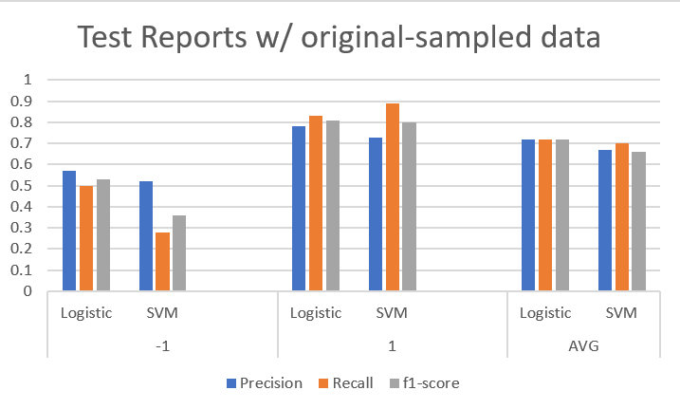
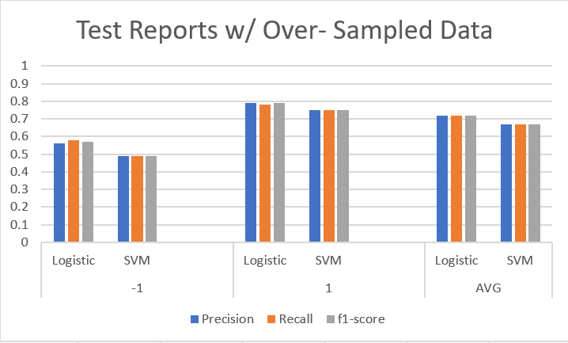
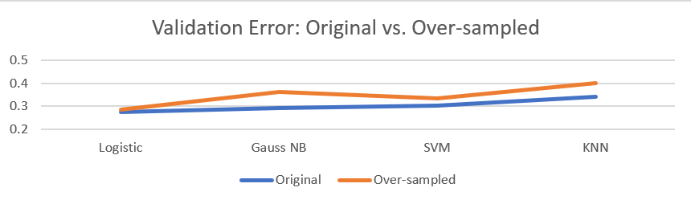
Part 5.2 Over-sampling
Notes:
During experiment, we found that there are much more reviews labeled as “helpful” than “unhelpful”. The unbalanced data will probably impede our progress in predicting “unhelpfulness”.
Therefore, we used the method of Oversample to adjust the distribution of dataset. And we compared originally sampled data and over-sampled data.
As a result, we found that the rate accuracy improved for “unhelpful” reviews, but slightly decreased for “helpful” reviews. Overall, the validation error is lower with originally sampled data.
There seems to be a tradeoff between better prediction on “less helpfulness” vs. better prediction on “helpfulness”. And we decided to use the original sampled data.

Slide 17
Part 5.3 Content Feature Extraction
Content Feature: TF-IDF (Frequency-inverse document frequency)
Training size = 8,000, Originally sampled
 | Logistic Regression | Gaussian Naïve Bayes | SVM | KNN
W/O Content Feature | 0.2722 | 0.2906 | 0.2717 | 0.3011
W/ Content Feature | 0.2725 | 0.3075 | 0.2841 | 0.3175
Best Model: Logistic Regression using 8,000 originally sampled data with features including text structure, word features and sentiment features.
Notes:
According to other literatures on Natural Language Processing, many of them used the method of TF-IDF(Frequency-inverse document frequency). The TF-IDF value increases proportionally to the number of times a word appears in the document and is offset by the frequency of the word in the corpus, which helps to adjust for the fact that some words appear more frequently in general.
Again, we trained on 8,000 originally-sampled data. Consequently, we found that for all 4 classification algorithms, the model performs better without content features.
To summarize, our best predicting model is a Logistic Regression using 8,000 originally sampled data with features including text structure, word features and sentiment features.

Slide 18
6. Further Improvements?
Notes:
【链接】During this project, we spent most of the time to do experiments by changing features, data size and algorithms. However, there are some other things we can do to improve the model performance.

Slide 19
Part 6 Project Limitations
Study on more detailed categories separately
Computational Effort
Notes:
Choice of Dataset:
Recall that in this project, we used data on Apps for Android. However, there are more detailed categories among these Apps, such as games, educational app, shopping app, and so on. Key words to express these apps vary a lot. Therefore, it could be helpful if we can study on the more detailed categories separately.
Computation Effort:
Our computer are unable to run smoothly in terms of a huge dataset. More things could be done to decrease the computational effort.

Slide 20
THANK YOU FOR WATCHING

